Slide 1
Overview – Inter unit communication In faceless Penalty
Version 1.0
Notes:
Training presentation on Inter Unit Communication functionality in Faceless Penalty.

Slide 2
Inter Unit Communication
Navigate to ITBA Portal → Penalty→ Menu → Inter Unit Communication
Inter Unit communication functionality is now made available in Faceless Penalty for communication between various units in faceless manner.
The communication between various units i.e. Assessment Unit, Review Unit & Technical Unit would be done through National Faceless Assessment Centre.
Click on Inter Unit Communication link
Communication can be done by logged on user at the same level i.e. AO of Assessment Unit can communicate with AO of other units i.e. Review Unit, Technical Unit likewise Range to Range or PCIT/CIT to PCIT/CIT or CCIT to CCIT or PCCIT to PCCIT in various units.
Note: Communications under this functionality shall not be part of Case History/Notings of Main Penalty workitem. Therefore, this functionality may be used primarily for reminders or other communication etc and not for making references or for other processes for which there are specific functionalities in ITBA.
Notes:
Users can initiate workflow from Menu provided in Penalty module
Go to ITBA Portal → Penalty→ Menu → Inter Unit Communication

Slide 3
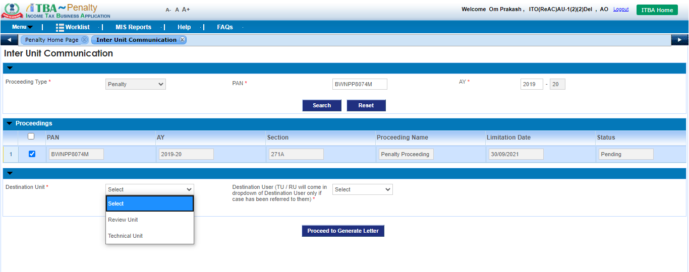
Inter Unit Communication (Initiation screen)
The approval workflow be applicable to AOs of various units i.e. Assessment Unit, Technical Unit, Review Unit and NaFAC users. For Range Heads and above users i.e. PCIT, CCIT & PCCITs in various units, approval is not required for generation of Communication Letter / Report in this process.
Proceeding Type will be auto selected as Penalty
Enter PAN
Enter AY
Click on Search button
Pending proceedings will be displayed to the user based on entered PAN and AY
Select the proceeding for which Inter Unit Communication needs to be exercised
Based on the selected Destination Unit, user will be displayed, Select the Destination User from the dropdown provided
Select the Destination Unit
Click on Proceed to Generate Letter
Notes:
User has to enter the details in this screen and click on Proceed to Generate Letter button for generating Inter Unit Communication Letter.

Slide 4
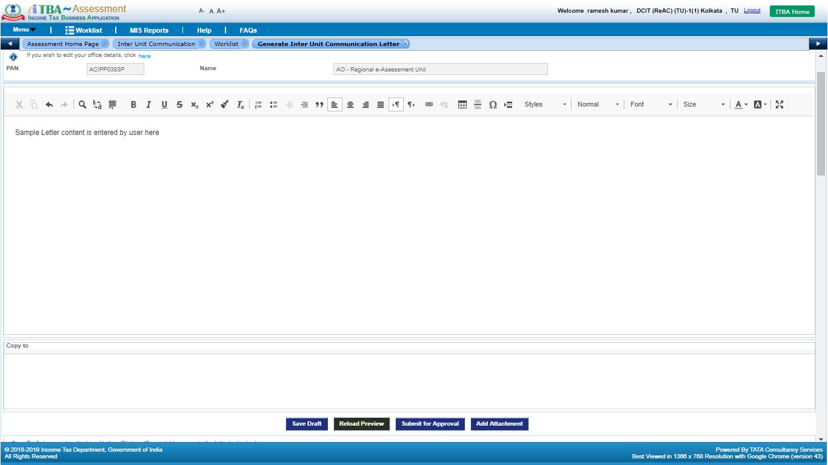
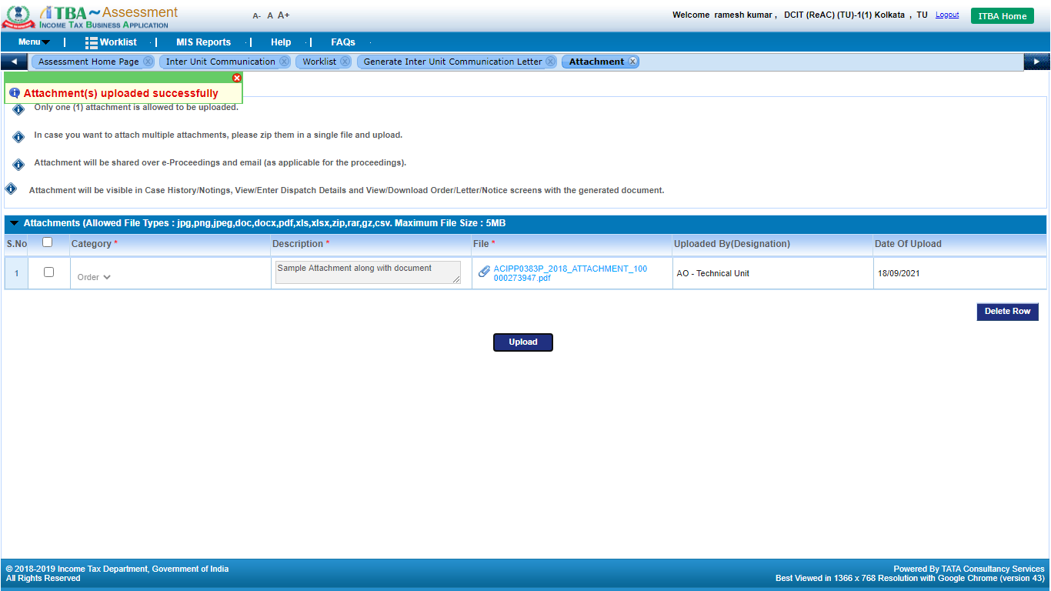
Inter Unit Communication Letter
Note: Approval is not applicable for generation of Communication Letter for Range Head and above users.
Enter the content to displayed in the Inter Unit Communication letter here
Click on Submit for Approval button to submit the draft request to Range Head for necessary approval.
Click on Save Draft to save the Letter content
Click on Add Attachment button to attach any document along with the letter
Notes:
User can also upload supporting attachment to be sent along with Inter Unit Communication Letter.

Slide 5
Letter Request (Submitted for Approval)
Notes:
Proposal for generation of Communication Letter is sent to Addl. AU /Addl. TU/ Addl. RU as the case maybe.

Slide 6
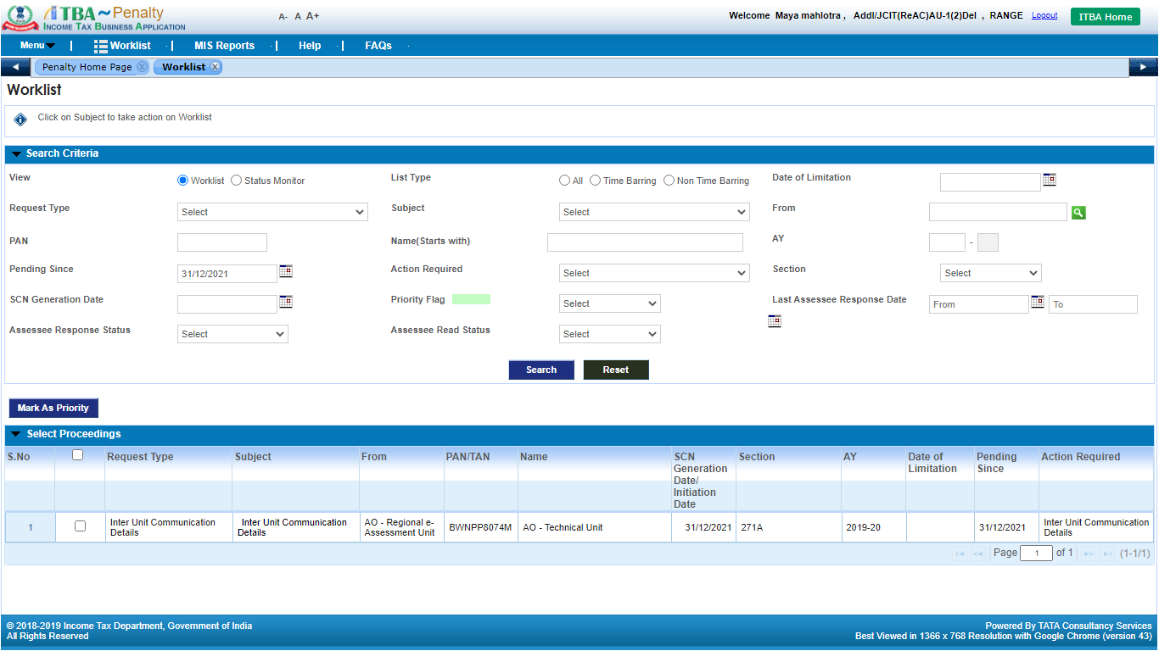
Penalty worklist
Click on Subject link to navigate to workitem
Notes:
From Worklist user can navigate to Inter Unit Communication workitem

Slide 7
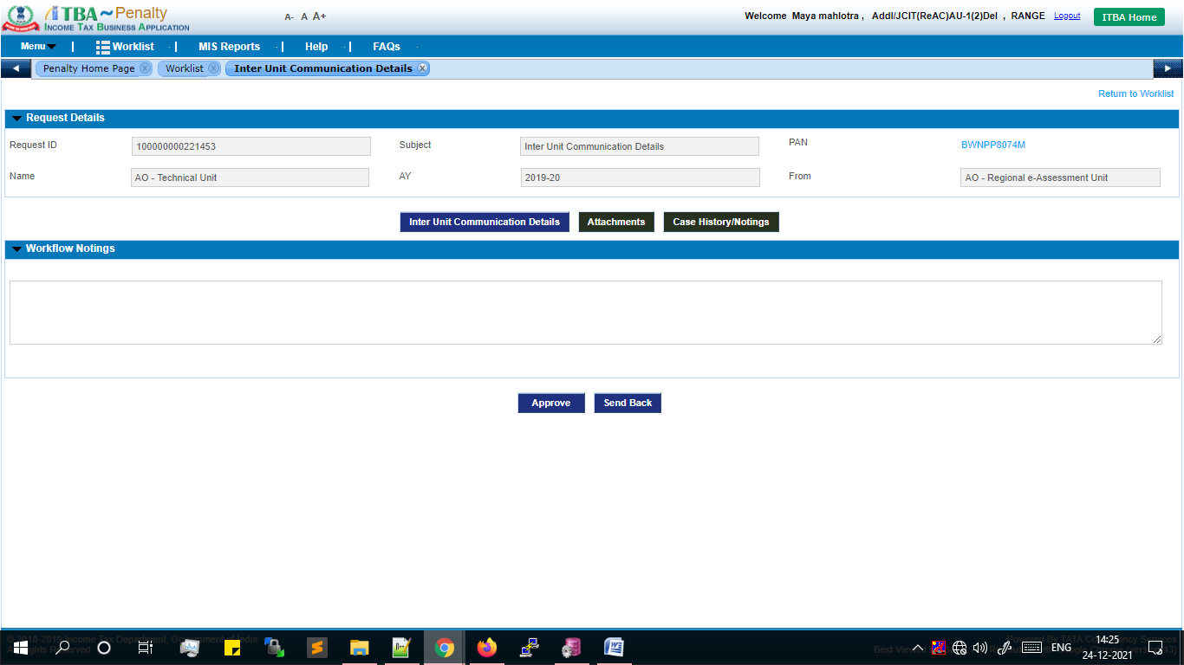
Proposal for Inter Unit Communication Letter
Click on Attachments button to add any supporting document.
Click on Inter Unit Communication Details button to view the details regarding communication as entered by AO
Click on Case History/Notings to view the history of the workitem
Click on Approve button to approve the letter for generation by AO
Click on Send Back button to send back the workitem to AO for necessary changes in the proposal.
Notes:
After navigating to the proposal workitem screen, user can attach any document from Attachments button. For viewing the Inter Unit Communication letter, user needs to click on Inter Unit Communication details button. User can also view the workflow related to the workitem through Case History/Notings button provided on the workitem.

Slide 8
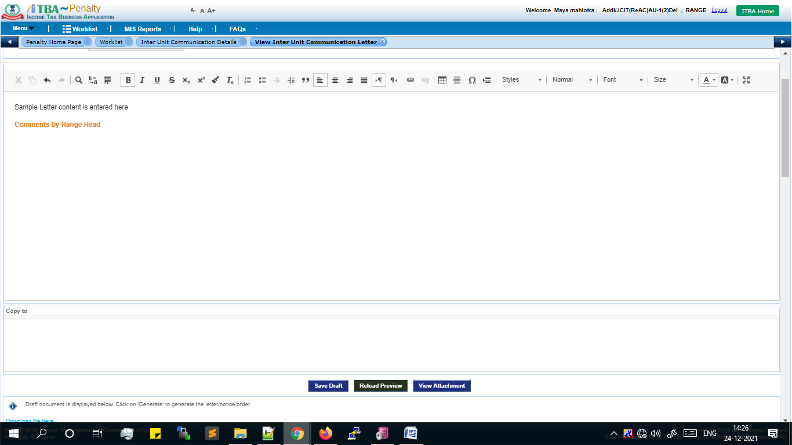
Inter Unit Communication Letter
The letter content is available to Range Head. User can update the content if required
Click on View Attachment button to view any document attached by AO
Click on Save Draft after editing the Letter content
Notes:
Here, the letter content entered by the AO/TU/RU will be visible to the Range which the user (if required) can edit and save by clicking on Save Draft. Also, the user can view/download the document attached by the AO that will be sent along with the Communication Letter by clicking on View Attachment button.

Slide 9
Proposal for Communication Letter
Enter Remarks in workflow Noting's
Click on Approve button to Approve the generation of Inter Unit Communication Letter
Notes:
Once the details are viewed/ edited by the Addl. AU/Addl. TU/Addl. RU, the user can either Approve the proposal or Send Back the proposal to AO for some clarification or changes or cancellation. In both the cases, user needs to enter remarks in workflow Notings and ten click on the Send Back/Approve (as per requirement).
Note : In the case depicted, the Addl. TU has approved the proposal.

Slide 10
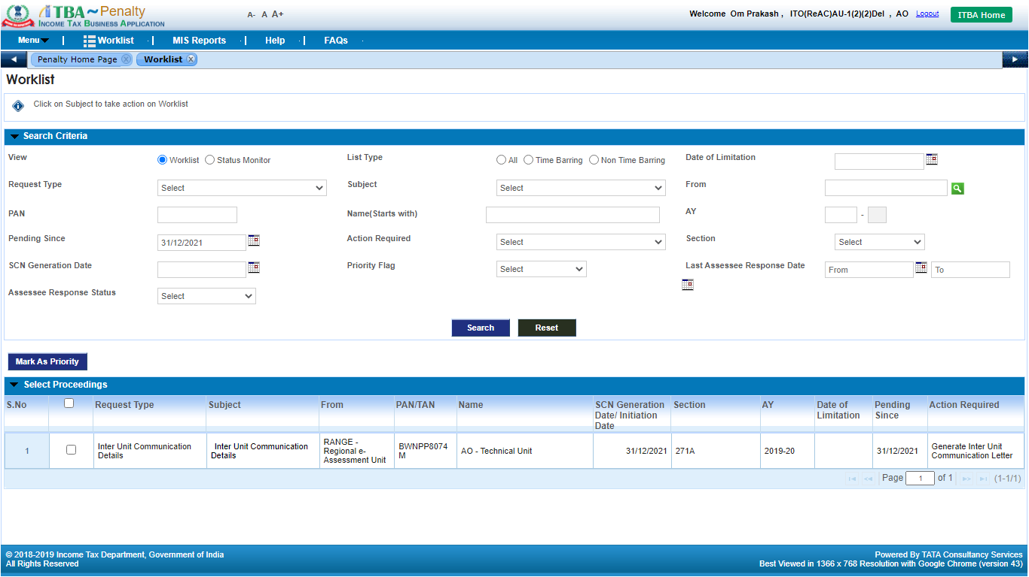
Penalty worklist
Click on Subject link to navigate to Inter Unit Communication workitem
Notes:
Once the case is approved by Addl. TU / Addl. AU / Addl. RU, the workitem will be visible to AO AU/TU/RU for the generation of Communication letter.

Slide 11
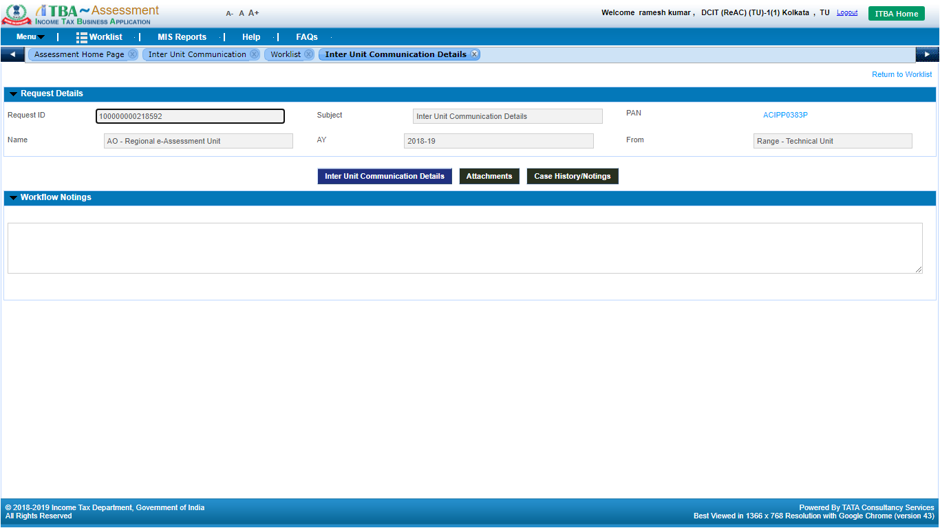
Inter Unit Communication workitem
Click on Inter Unit Communication Details to proceed with generation
Notes:
Click on Inter Unit Communication Letter button to proceed with generation of Communication Letter

Slide 12
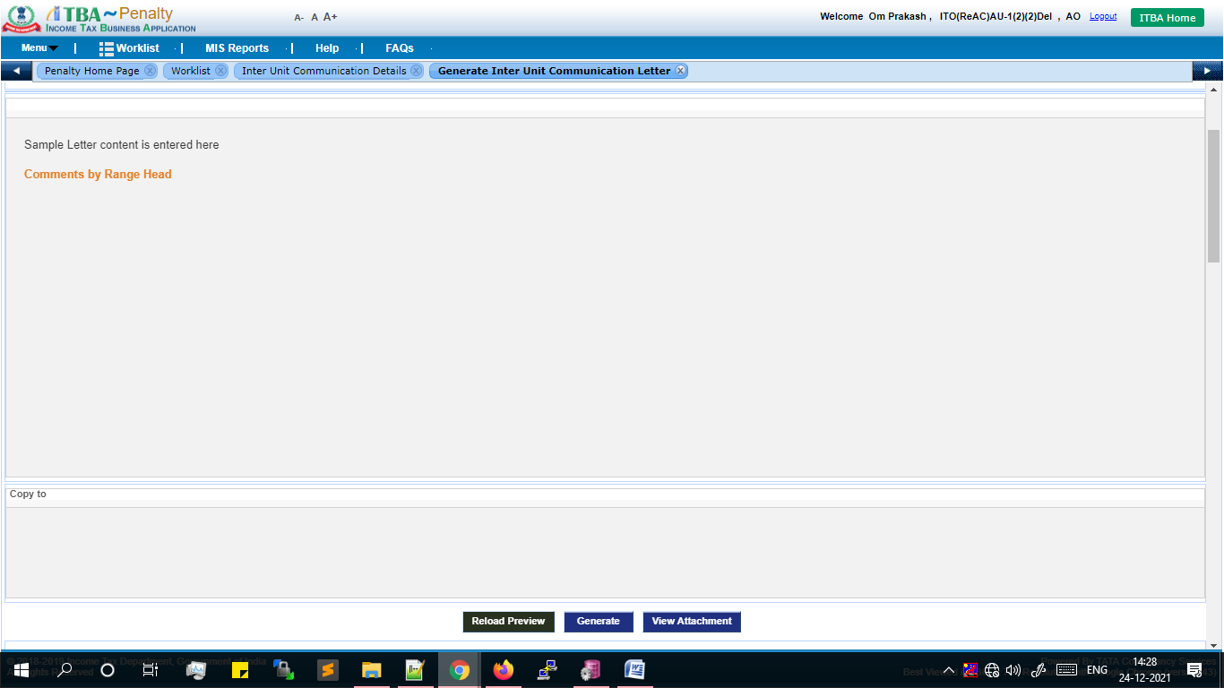
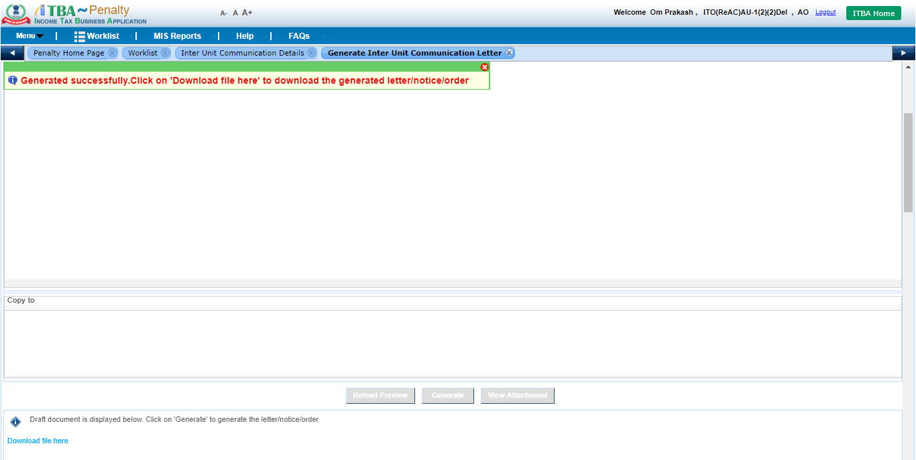
Inter Unit Communication Letter
On click of generate, Inter Unit Communication Letter will be generated. User can click on Download File Here button to download the letter. Generated letter will also be available in View/Download-Order/Letter/Notice screen for download.
Click on Generate button to generate Communication Letter
Notes:
On click of generate, Inter Unit Communication Letter will be generated. User can click on Download File Here button to download the letter. Generated letter will also be available in View/Download-Order/Letter/Notice screen for download.

Slide 13
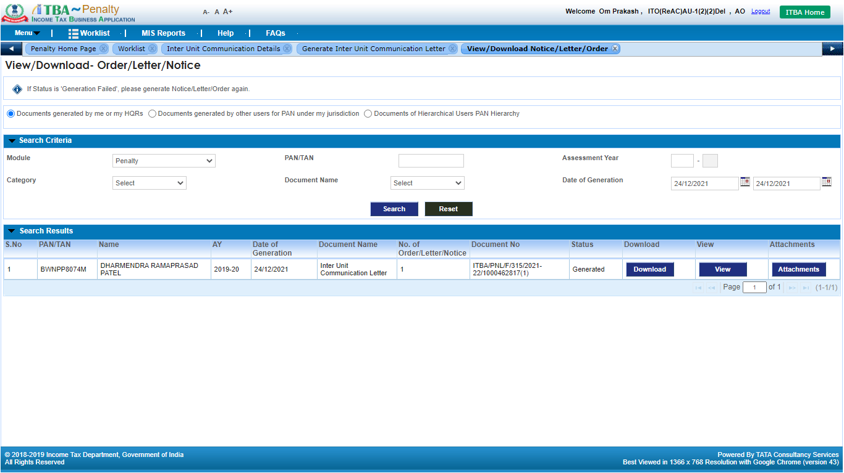
View/Download Letter/Notice/Orders
Click on Download button to download the generated Letter

Slide 14
Sample Inter Unit Communication Letter

Slide 15
Penalty worklist
Click on Subject link to navigate to Inter Unit Communication workitem
Notes:
The Destination ITD user will login the ITBA Application, navigate to the Penalty module and in the Worklist of the module, a pendency will be available for the user to work upon the mentioned case. User can check for the case by clicking on the Subject link of the proceeding.

Slide 16
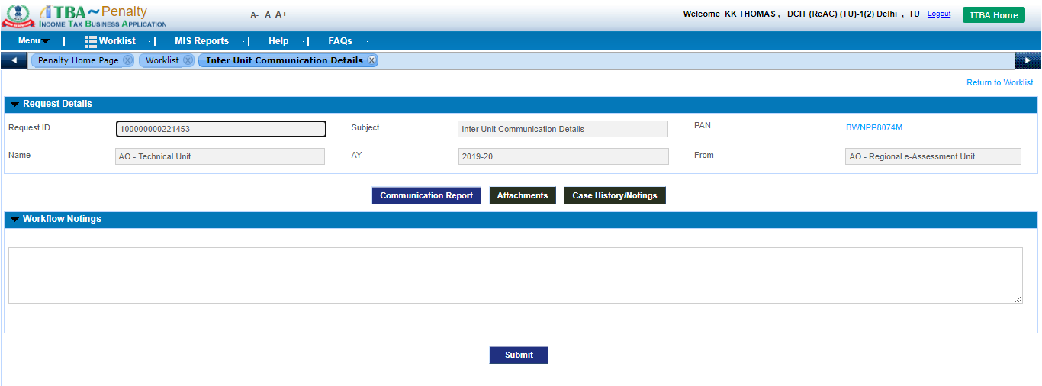
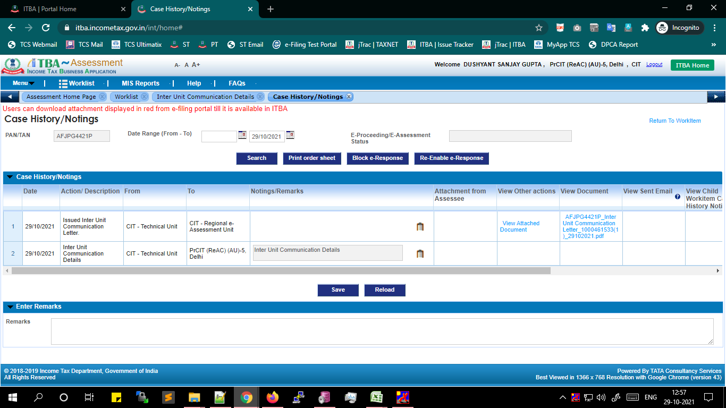
Inter Unit Communication workitem
Click on Case History/Notings to view the letter issued by Source ITD user
Click on Communication Report to proceed with preparation of Communication Report
Click on Attachments to add any supporting documents

Slide 17
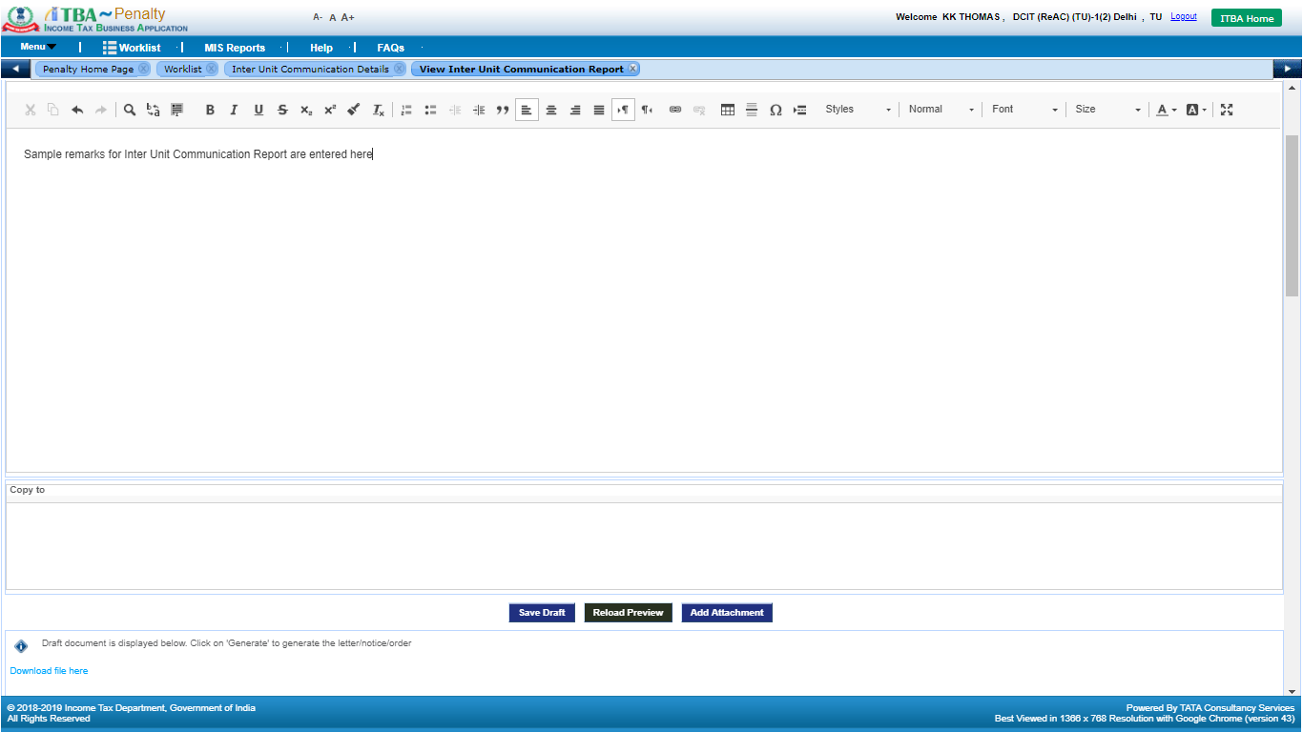
Communication Report
Enter the content for Communication Report
Click on Add Attachment button to attach any document with the Communication report
Click on Save Draft button to save the details in the system
Notes:
For preparing the Communication Report, user navigated to the Communication Report screen where the content entered can be free-text along with the facility to add attachment from Add Attachment button.

Slide 18
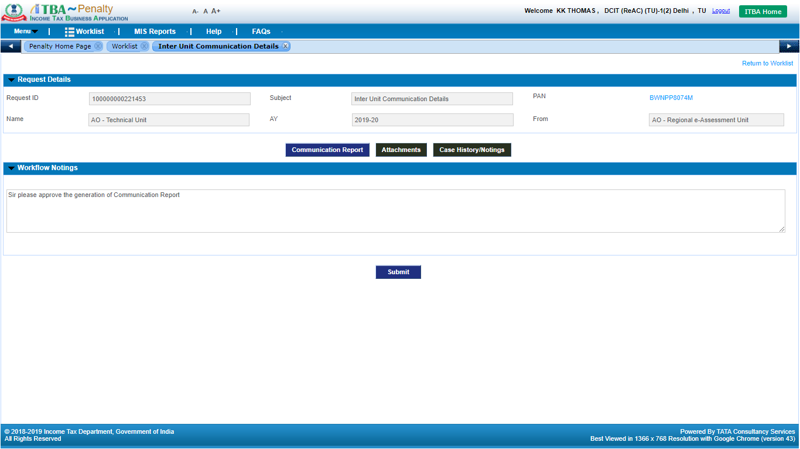
Inter Unit Communication workitem
Enter details in Workflow Notings
Once the content for Communication Report is entered, navigate back to workitem screen. Enter remarks in Workflow Notings and click on Submit button
Notes:
Once the Report is prepared by the user, user needs to navigate back to the Workitem screen in order to send the proposal to Addl. AU / Addl. TU / Addl. RU for approval before generation of the report. For submission, user needs to enter remarks in Workflow Notings and then click on Submit button. On clicking the button, the workitem will be transferred to the Range worklist for approval.

Slide 19
Penalty worklist (Range)
Click on Subject link to navigate to Inter Unit Communication workitem
Notes:
The Inter Unit Communication workitem will be available to Addl. AU / Addl. TU/ Addl. RU in Penalty Worklist for approval. Navigate to the workitem by clicking on the Subject link.

Slide 20
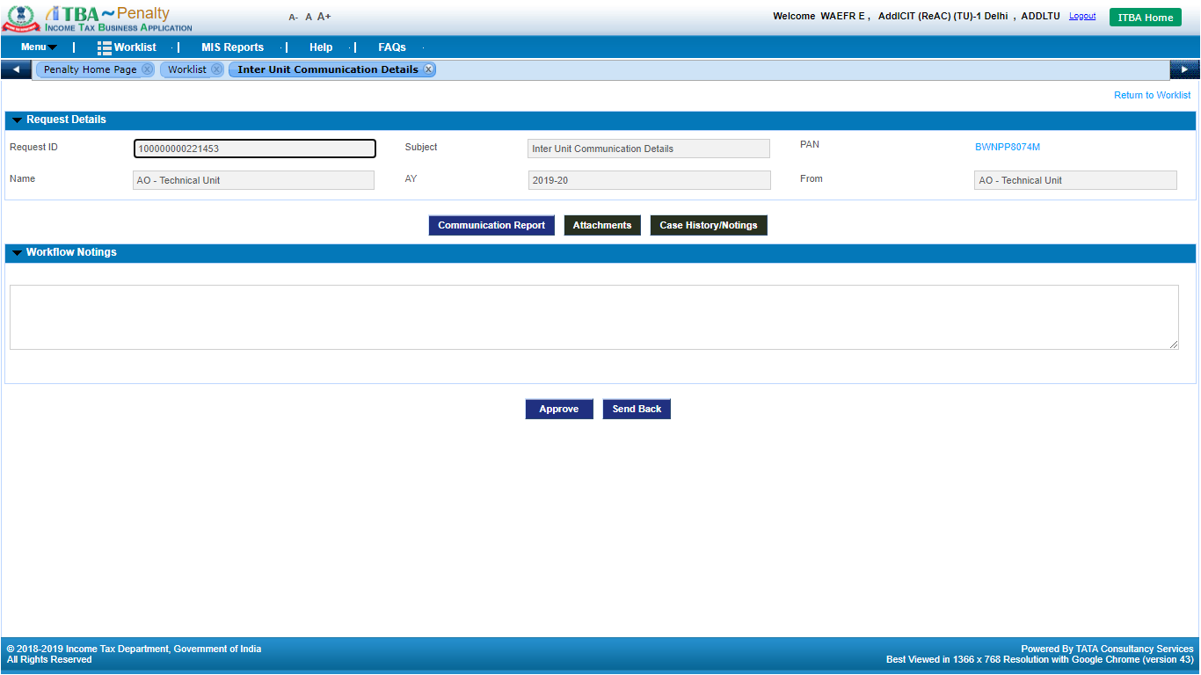
Inter Unit Communication workitem (Range)
Click on Communication Report to view the Inter Unit Communication Report details entered by AO
Click on Attachments to add any supporting documents
Click on Case History/Notings to view the workflow history of the workitem
Notes:
In this Workitem, the Range can download the Communication Letter issued by Source ITD user in Case History Notings screen. User can view the Communication Report prepared by AO AU/TU/RU by clicking on Communication Report button, can add attachment from Attachments button and can view the history of the workitem by Case History/Notings button on the workitem.

Slide 21
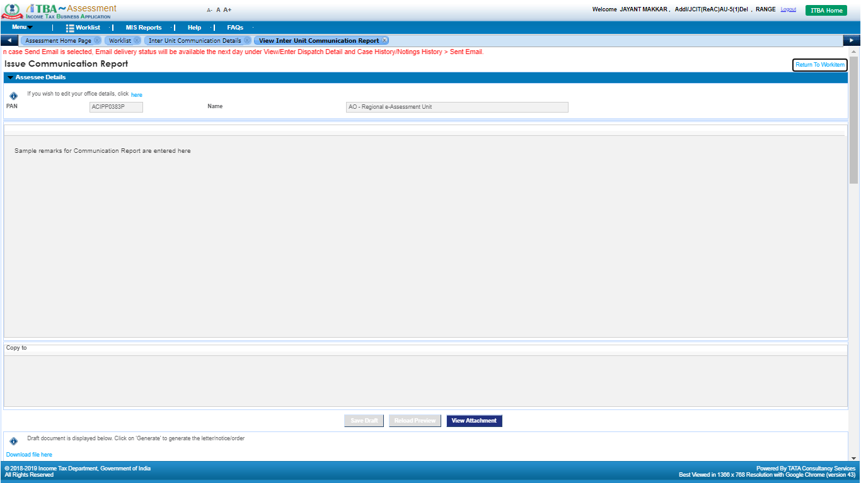
Inter Unit Communication Report
The content for the Inter Unit Communication Report will be displayed in read-only mode, In case any changes are required in the report, Range user can use Send Back functionality provided in the workitem screen
Notes:
The Communication Report prepared by AO AU/TU/RU will be visible in read-only mode to the Range. If the user requires any change in the report, user needs to send back the workitem to the AO for any changes from the workitem screen.

Slide 22
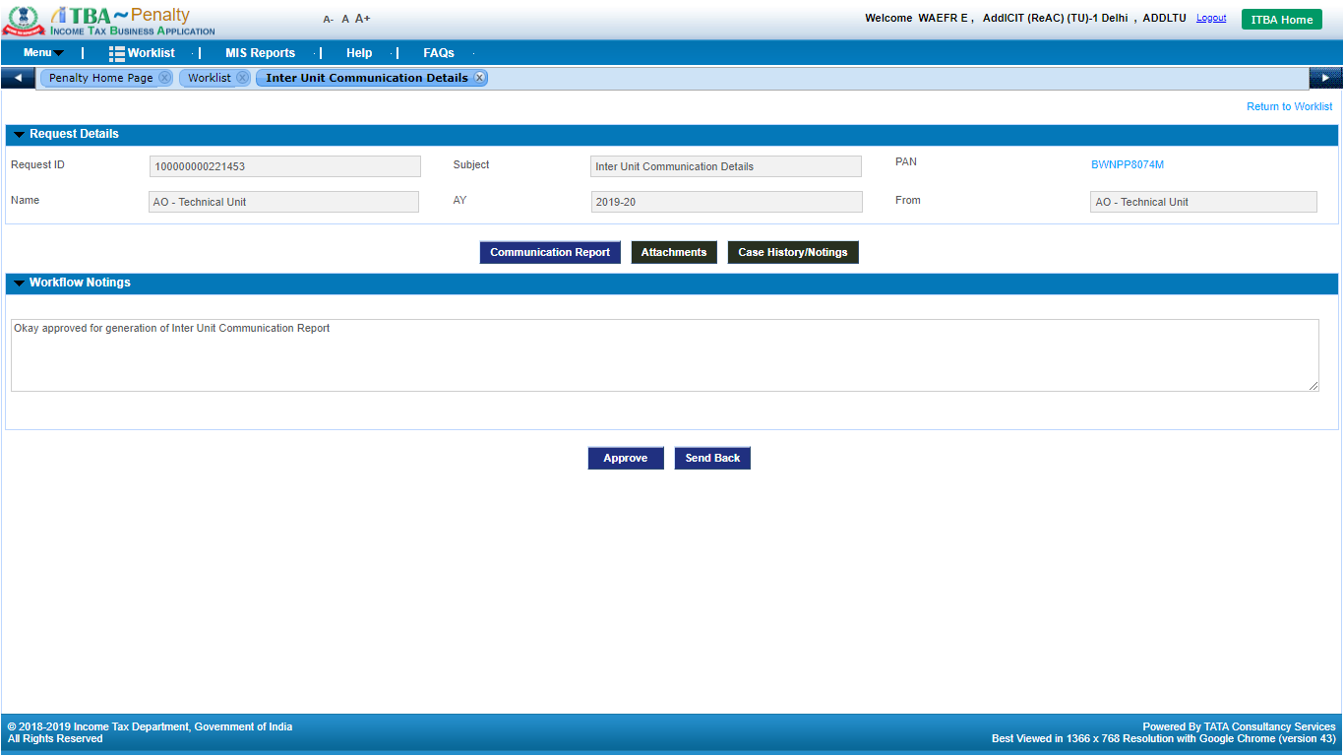
Inter Unit Communication workitem
Enter remarks in Workflow Notings
Click on Send Back to send back the workitem to AO for changes/updates to the Communication Report content
Click on Approve to approve the generation of Inter Unit Communication Report by AO
Notes:
Navigate back to the workitem screen in order to Approve/ Send Back the Communication Report. Enter the remarks in the Workflow/ Notings and click on either Send back/Approve (as per the requirement )
Note : The case depicted here is approved by the Range.

Slide 23
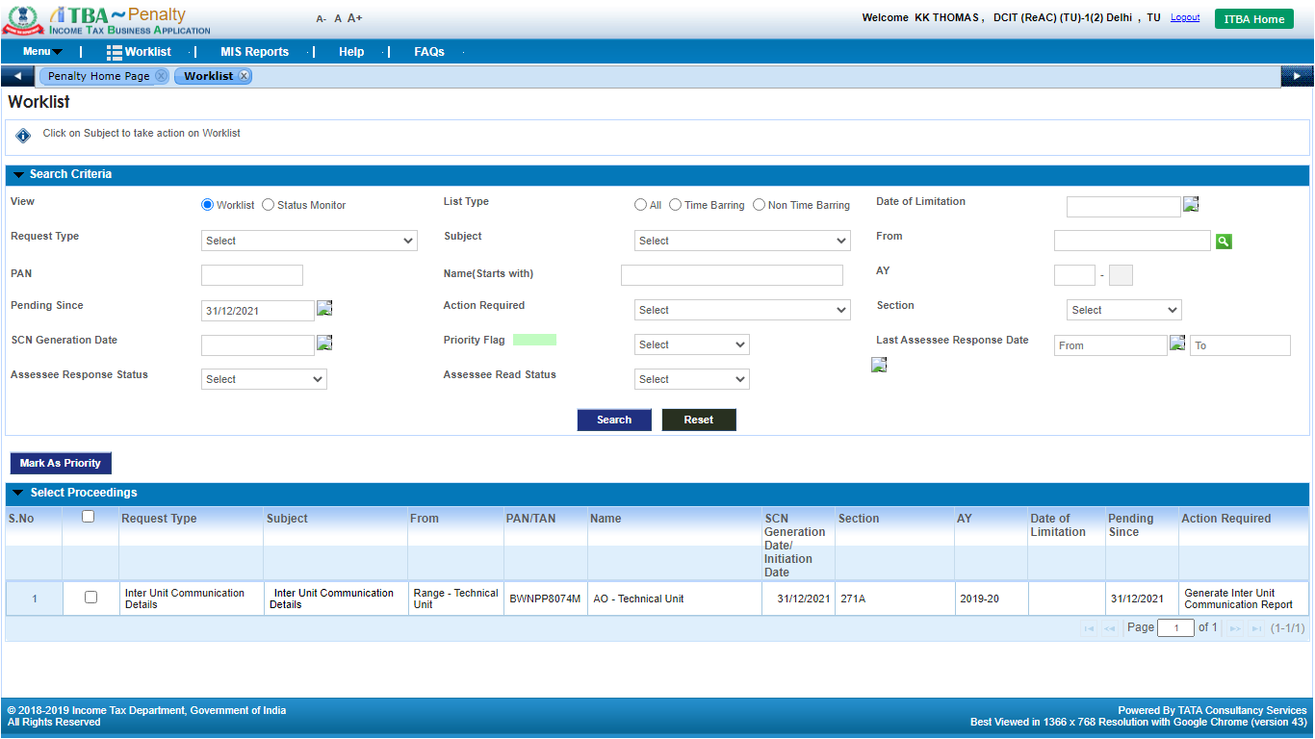
Penalty worklist (AO)
Click on Subject link to navigate to Inter Unit Communication workitem
Notes:
For AO, once the report is approved, the workitem will be available to the AO AU/TU/RU for generation. Navigate to the workitem screen by clicking on the Subject link.

Slide 24
Inter Unit Communication workitem (Post approval by Range )
Click on Communication Report to proceed with generation of Inter Unit Communication report
Notes:
Click on the Communication Report button to proceed to generate the report.

Slide 25
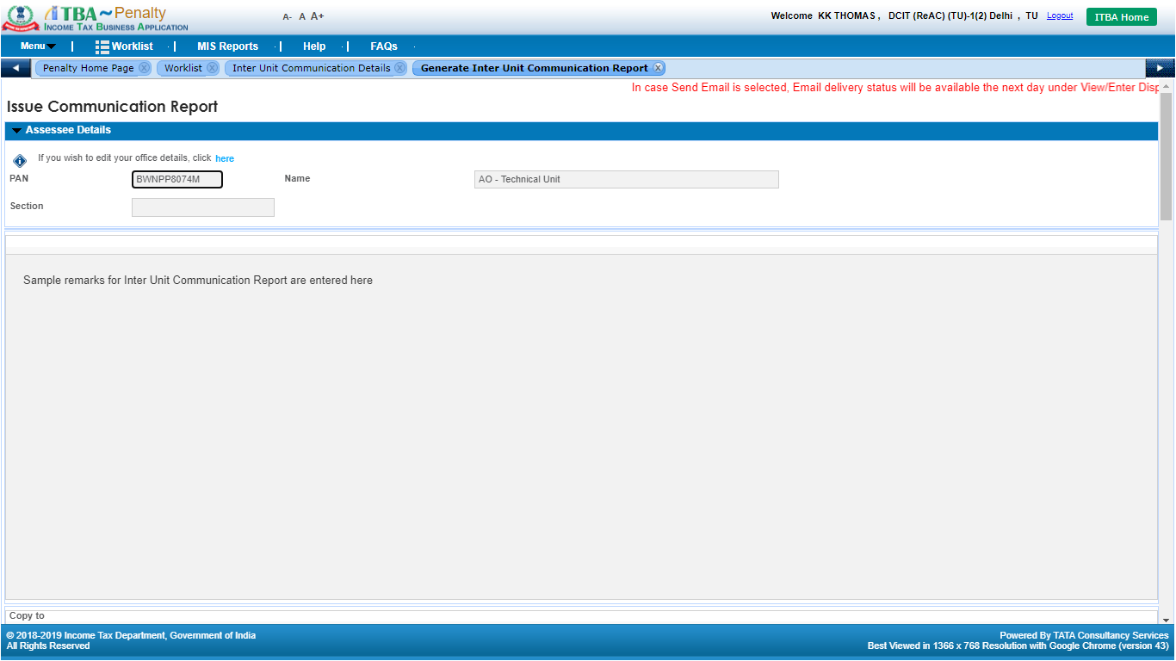
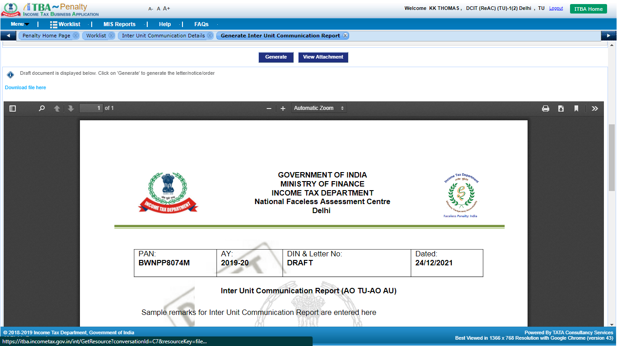
Communication Report generation
Click on Generate button to generate the Communication Report
Notes:
The approved content will be available in the read-only mode to the user . Click on Generate to generate the Report

Slide 26
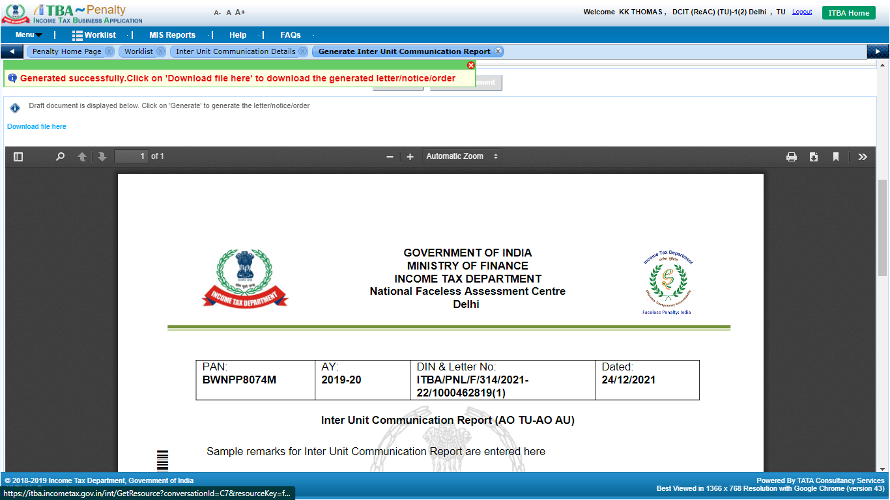
Communication Report (Generated)
Post generation of the Communication Report by AO, user will be able to download the document by clicking on Download File Here link. The document will be visible in the Case History/Notings of the Inter Unit Communication workitem available with Source Unit AO
Notes:
Post generation of the Communication Report by AO, user will be able to download the document by clicking on Download File Here link. The document will be visible in the Case History/Notings of the Inter Unit Communication workitem available with Source Unit AO

Slide 27
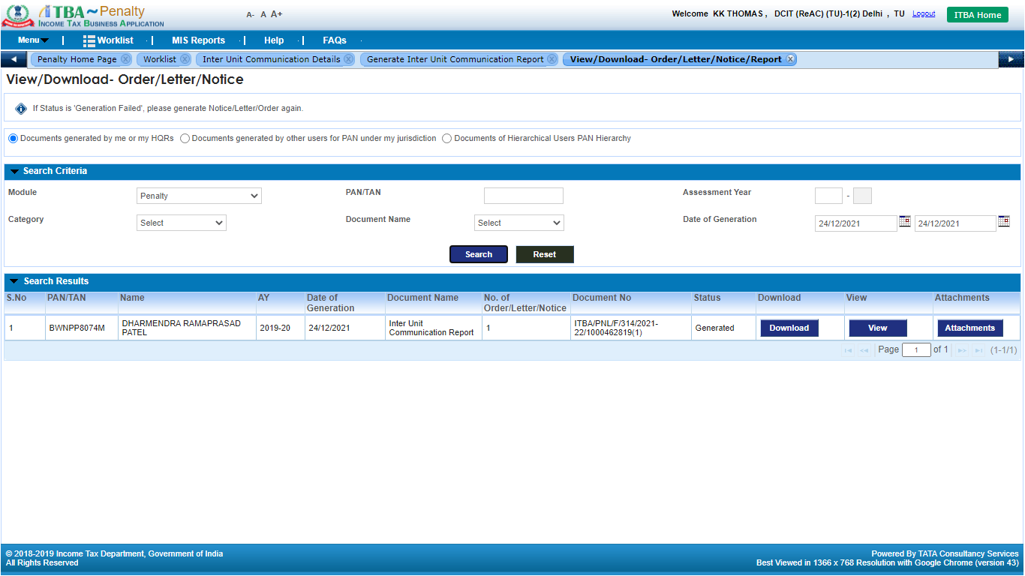
View/Download Letter/Notice/Orders
Click on Download button to download the generated report
Notes:
User can download the Report from View /Download Order Letter Notice screen

Slide 28
Sample Inter Unit Communication report
Notes:
Sample Inter Unit Communication Report

Slide 29
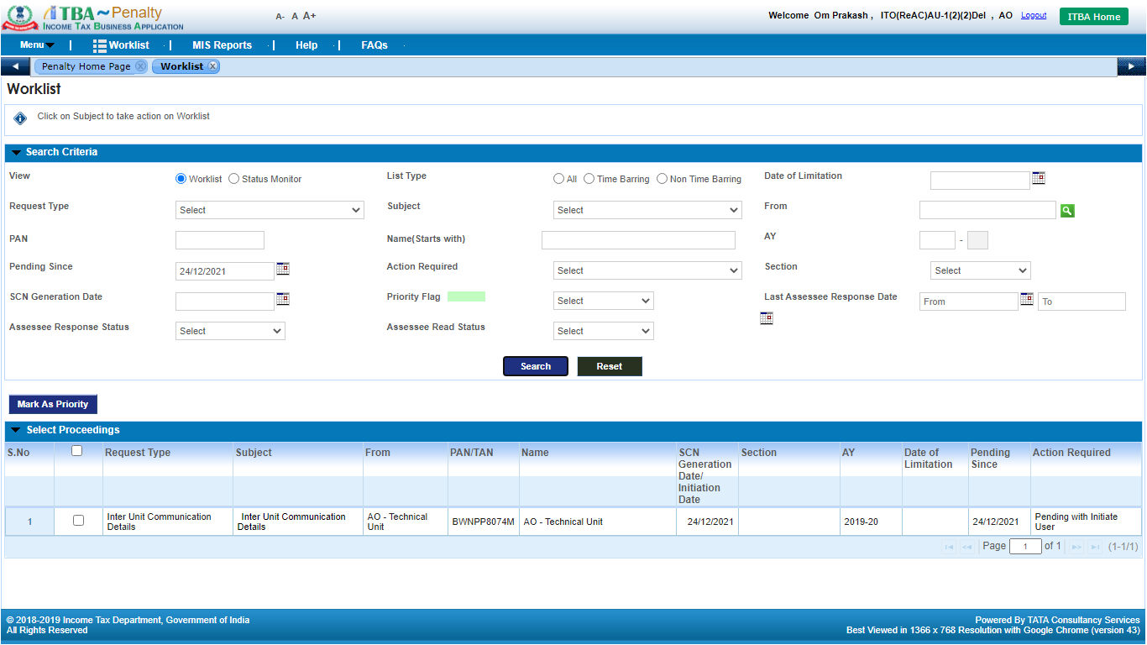
Penalty worklist
Click on Subject link to navigate to the workitem
Notes:
The workitem will be available to Source ITD user in Penalty worklist.

Slide 30
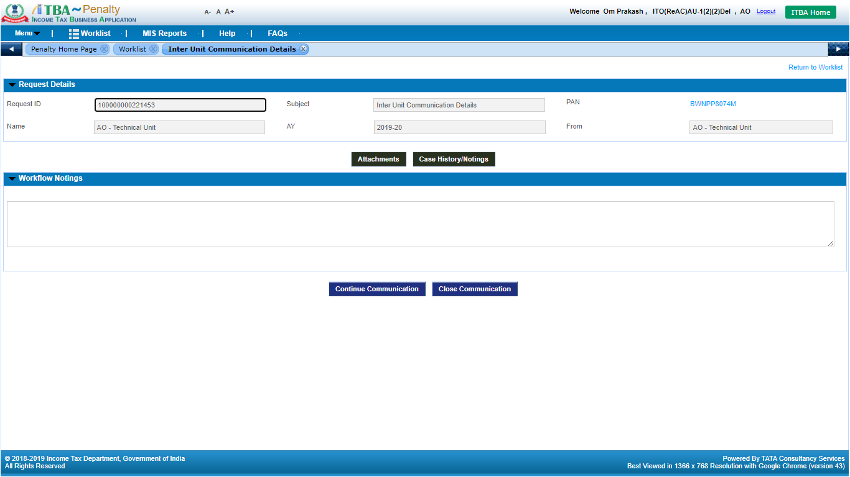
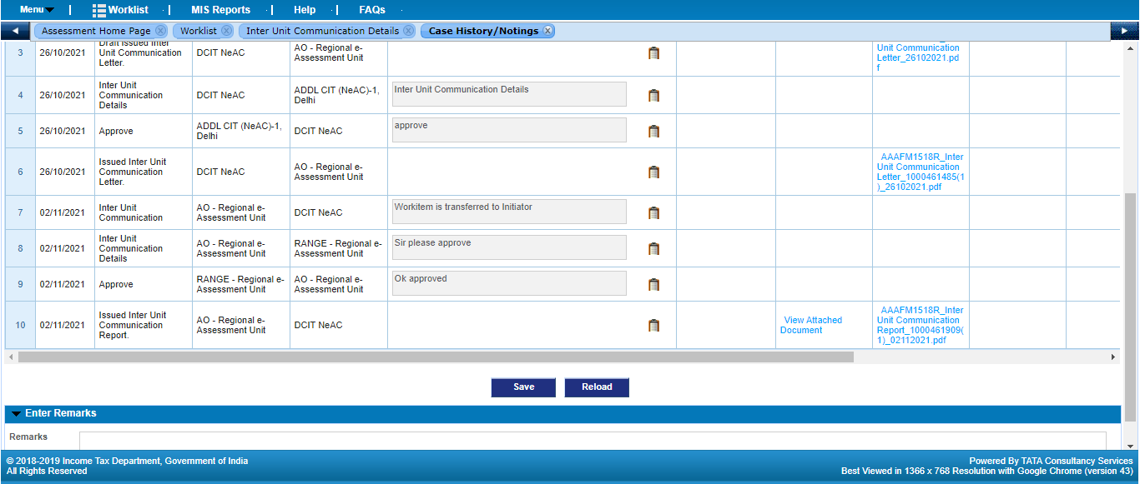
Inter Unit Communication workitem (Source user)
Click on Case History/ Notings button to view the Communication report along with attachments, if any
Click on Attachments button to view the supporting attachments in the Communication workflow, user can also upload documents related to the case
The workitem will move to Destination ITD user’s worklist (Penalty). Destination ITD user will provide remarks in Workflow Notings and click on Submit to Initiator button. Users can also attach supporting documents in Attachment screen provided in workitem.
In case any other information is required from Destination ITD user, enter remarks in Workflow Notings and click on Continue Communication
If necessary communication is complete, Source ITD user will be able to close the workitem by entering remarks in Workflow Notings and clicking on Close Communication
Note: The process will be applicable to AOs of various units i.e. Assessment Unit, Technical Unit, Review Unit and NaFAC users. For Range Heads and above users i.e. PCIT, CCIT &PCCITs in various units, approval is not required for generation of Communication Letter / Report in this process.
Notes:
User can view the Inter Unit Communication Report in Case History/Notings screen available in the workitem.

